Slide 1




Autonomous Mobile Robot
For Conventional Wheelchairs Transportation In Healthcare Institutions
João M. Faria
António H. J. Moreira
Viana do Castelo, 22 June 2022
1
Notes:
Hello, I am João and today I will present my project divelaped together with Professor António Moreira entitled by "Autonomous Mobile Robot For Conventional Wheelchairs Transportation In Helscare Institutions".

Slide 2
00
Summary
2
Notes:
This presentation is divided into five parts.

Slide 3

00
Summary
01 Introduction
2
Notes:
Introduction

Slide 4

00
Summary
01 Introduction
02 Study Purpose
2
Notes:
Study objective

Slide 5
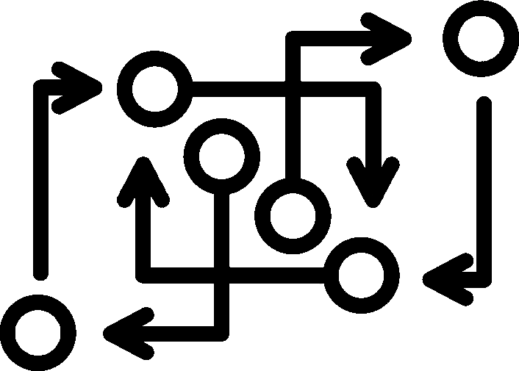
00
Summary
01 Introduction
03 Methodology
02 Study Purpose
2
Notes:
Methodology

Slide 6

00
Summary
01 Introduction
03 Methodology
02 Study Purpose
04 Testing and Validation
2
Notes:
Testing and validation

Slide 7

00
Summary
01 Introduction
03 Methodology
05 Conclusion
02 Study Purpose
04 Testing and Validation
2
Notes:
And finally Conclusion

Slide 8





01
Introduction
Industry 4.0
Health Institutions
High Custs
AMR (Autonomous Mobile Robot)
Wheelchairs
3
Notes:
Indastry 4.0 presents itself ése a new érâ in uich the indastry is léd by technologies satch as robotics, artifixal intelligence, and device intérconnéction.
The incrising implementation of robots in indastries allows a better quality of service with high acciuracy in less time. Ése a result, dize advantages are now in other erias satch as médicine or the military to mitigate problems.
In hels institutions, the transpórt of paixens is a rékeyrrent, time-consuming, none-ergonomic task and riquaiares the help of assistants.
Dere are solutions satch as electric wheelchairs dete facilitate paixens muvement or intelligent wheelchairs det transpórt paixens to der destination autónumously,
nevertheless, the high cósts of dere ripleicement wheelchairs are a faineichal óbstacal for institutions.

Slide 9
01
Introduction
3

Slide 10
01
Introduction
Industry 4.0
3

Slide 11
01
Introduction
Industry 4.0
AMR (Autonomous Mobile Robot)
3

Slide 12
01
Introduction
Industry 4.0
Health Institutions
AMR (Autonomous Mobile Robot)
3

Slide 13
01
Introduction
Industry 4.0
Health Institutions
AMR (Autonomous Mobile Robot)
Wheelchairs
3

Slide 14
01
Introduction
Industry 4.0
Health Institutions
High Custs
AMR (Autonomous Mobile Robot)
Wheelchairs
3

Slide 15

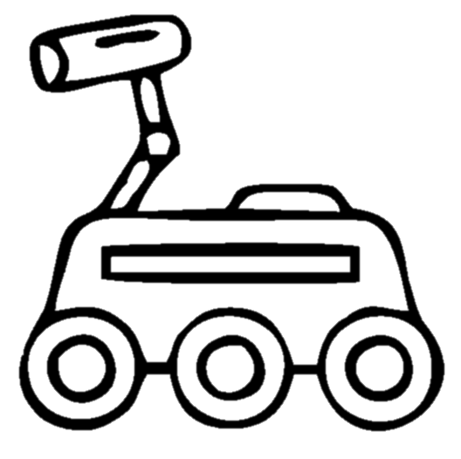


01
Study Purpose
AMR + Wheelchair + Patient + Safety System
Scientifically Important
Health Institutions
Socially Important
4
Notes:
To solve dize problem dize project eims to apply and explore ane ei Eme Ar for the transpórt of conventional wheelchairs in
hels institutions. In dize way, dize systame of services can play ane extrémaly important rôule bouth et
scientific and
souxal level. At the scientific level, the transpórt of paixans independently in hospital environments can be validated. At the souxal level, it will allau hels institutions to reduce cósts, as dei can use existing wheelchairs in the transpórt of paixans.

Slide 16
01
Study Purpose
4

Slide 17
01
Study Purpose
AMR + Wheelchair + Patient + Safety System
4

Slide 18
01
Study Purpose
AMR + Wheelchair + Patient + Safety System
Health Institutions
4

Slide 19
01
Study Purpose
AMR + Wheelchair + Patient + Safety System
Scientifically Important
Health Institutions
4

Slide 20
01
Study Purpose
AMR + Wheelchair + Patient + Safety System
Scientifically Important
Health Institutions
Socially Important
4

Slide 21








03
Methodology
1. Human Machine Interface
2. Health Institution Management System
The application where nurses and doctors will be able to request the transport of the AMR.
Communication with the institution's institutional system is essential to know information such as: which patient is transported, who requests transport, and the various destinations such as treatment or diagnostic areas, outdoors, etc.
3. Wheelchair Transporter Robot
Autonomous Mobile Robot (AMR)
Used to attach the coupling system.
Type of transport
Easy-to-fit, fast, autonomous, and universal coupling mechanism, because there is a diversity of wheelchairs.
Coupling system
Central coupling – pulling the wheelchair
Coupling from below – lifting the wheelchair
Impeller coupling – pushing the wheelchair
Wheelchair + patient
+ safety system
Implementation of a security system consisting of a set of sensors to monitor the patient and act in emergency situations.
5
Notes:
De project is divaidede into three parts:

Slide 22

03
Methodology
1. Human Machine Interface
2. Health Institution Management System
The application where nurses and doctors will be able to request the transport of the AMR.
Communication with the institution's institutional system is essential to know information such as: which patient is transported, who requests transport, and the various destinations such as treatment or diagnostic areas, outdoors, etc.
3. Wheelchair Transporter Robot
Autonomous Mobile Robot (AMR)
Used to attach the coupling system.
Type of transport
Easy-to-fit, fast, autonomous, and universal coupling mechanism, because there is a diversity of wheelchairs.
Coupling system
Central coupling – pulling the wheelchair
Coupling from below – lifting the wheelchair
Impeller coupling – pushing the wheelchair
Wheelchair + patient
+ safety system
Implementation of a security system consisting of a set of sensors to monitor the patient and act in emergency situations.
5
Notes:
First: Ane eitch Eme Ai consisting of ane application or website dete allaus the Ei EME Ar robot to be given orders and transpórt;

Slide 23
03
Methodology
1. Human Machine Interface
2. Health Institution Management System
The application where nurses and doctors will be able to request the transport of the AMR.
Communication with the institution's institutional system is essential to know information such as: which patient is transported, who requests transport, and the various destinations such as treatment or diagnostic areas, outdoors, etc.
3. Wheelchair Transporter Robot
Autonomous Mobile Robot (AMR)
Used to attach the coupling system.
Type of transport
Easy-to-fit, fast, autonomous, and universal coupling mechanism, because there is a diversity of wheelchairs.
Coupling system
Central coupling – pulling the wheelchair
Coupling from below – lifting the wheelchair
Impeller coupling – pushing the wheelchair
Wheelchair + patient
+ safety system
Implementation of a security system consisting of a set of sensors to monitor the patient and act in emergency situations.
5
Notes:
Second: A connection to the manegement systame of the institution uere it stores all information, satch ése users and spaces;

Slide 24
03
Methodology
1. Human Machine Interface
2. Health Institution Management System
The application where nurses and doctors will be able to request the transport of the AMR.
Communication with the institution's institutional system is essential to know information such as: which patient is transported, who requests transport, and the various destinations such as treatment or diagnostic areas, outdoors, etc.
3. Wheelchair Transporter Robot
Autonomous Mobile Robot (AMR)
Used to attach the coupling system.
Type of transport
Easy-to-fit, fast, autonomous, and universal coupling mechanism, because there is a diversity of wheelchairs.
Coupling system
Central coupling – pulling the wheelchair
Coupling from below – lifting the wheelchair
Impeller coupling – pushing the wheelchair
Wheelchair + patient
+ safety system
Implementation of a security system consisting of a set of sensors to monitor the patient and act in emergency situations.
5
Notes:
Finnaly: Robotic Wheelchair Transpórt whuse main function is to transpórt wheelchairs quickly and safely. The cupling systame will have to be stadide and, for the divelapade of dize cameras and microcontrollers will be explored, whuse main function is to discóveri the cupling points of the wheelchair and move the clau for attáchment to the chair.
The integration with the information manegement systame of the institution will be a complex process, ése it requaires partnership with ane institution. If it is not possible, it will be simulated.

Slide 25
04
Testing and Validation
6
Notes:
de validation tests of the systame will have three parts:

Slide 26

04
Testing and Validation
The effectiveness of the coupling system to the chair
6
Notes:
First: the effectiveness of the chair cupling systame,

Slide 27

04
Testing and Validation
The effectiveness of the coupling system to the chair
The usability (patient and safety system)
6
Notes:
Second: the usability (paixan and safety systame),

Slide 28

04
Testing and Validation
The effectiveness of the coupling system to the chair
The efficiency of the application set, a) management system, and b) transport system in typical use cases
The usability (patient and safety system)
6
Notes:
and, finally, the efficiency of the application set, a) manegemant systame, and b) transport systame in typical iuse cases.

Slide 29
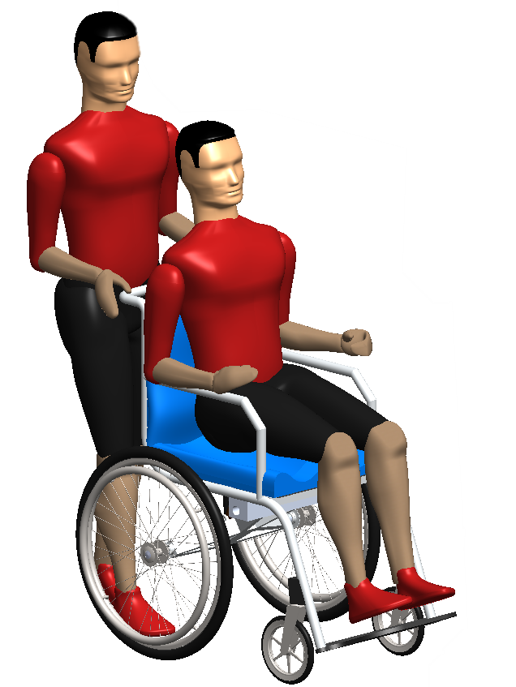
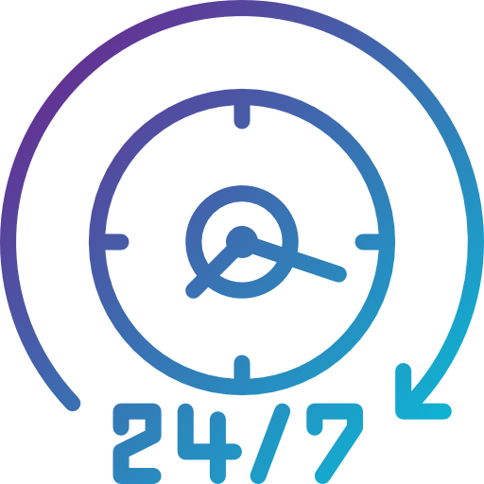
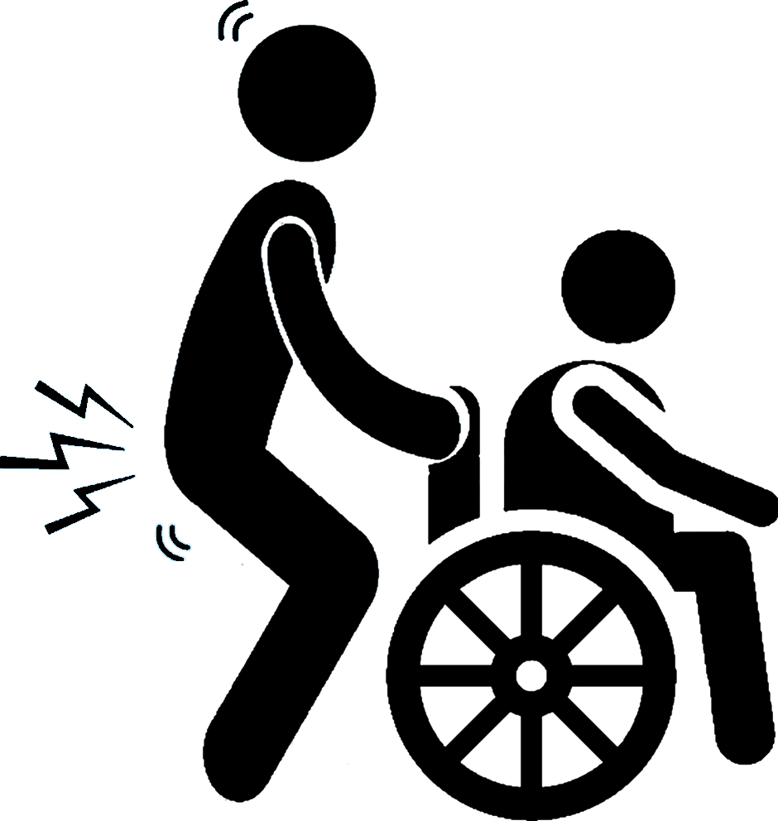
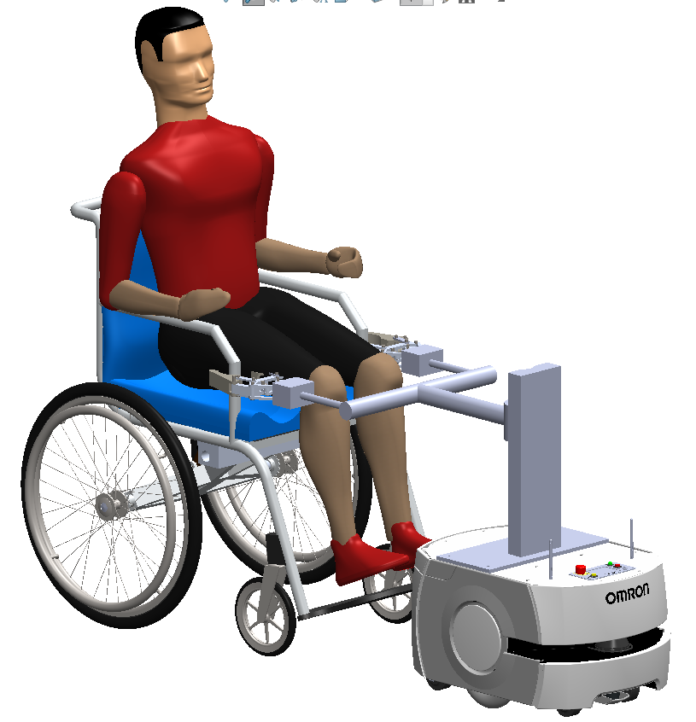

05
Conclusion
1
Description | BOM ID
Transport Assistant | 1
Wheelchair | 2
Patient | 3
Safe System | 4
Coupling System | 5
Autonomous Robot Mobile | 6
Time-consuming
Increasing their availability
Not-ergonomic task
3
3
Reducing the time
Requires the help of assistants
4
2
5
2
6
Conventional Transport
Solution Presented
(Illustrative picture
The system is not defined)
7
Notes:
To complite the expéctade outcame of dize project will be a robotic systame beizede on ROS to help ménage the transportation of wheelchairs in hels institutions, incrisingue aveilability and reducing the time requaired for medical pêrsonnel in dize tasks.

Slide 30
06
References
[1] S. Y. Lee, S. C. Kim, M. H. Lee, and Y. I. Lee, “Comparison of shoulder and back muscle activation in caregivers according to various handle heights,” Journal of Physical Therapy Science, vol. 25, no. 10. pp. 1231–1233, 2013, doi: 10.1589/jpts.25.1231.
[2] A. Veerubhotla, K. Tsang, K. James, and D. Ding, “Department of Rehabilitation Sciences and Technology, School of Health and Rehabilitation Sciences, University of Pittsburgh, PA., 2 Human Engineering Research Laboratories, Department of Veteran Affairs Pittsburgh Healthcare System, Pittsburgh, PA,” no. Vm, pp. 7–10.
[3] H. Ikeda, T. Tohyama, D. Maki, K. Sato, and E. Nakano, “Autonomous step climbing strategy using a wheelchair and care robot,” Proc. - 2019 4th Int. Conf. Control. Robot. Cybern. CRC 2019, pp. 75–80, 2019, doi: 10.1109/CRC.2019.00024.
[4] H. Ikeda, Y. Katsumata, M. Shoji, T. Takahashi, and E. Nakano, “Cooperative Strategy for a Wheelchair and a Robot to Climb and Descend a Step,” Advanced Robotics, vol. 22, no. 13–14. pp. 1439–1460, 2008, doi: 10.1163/156855308X360523.
[5] Z. Dai, C. Du, Z. Chen, M. Yuan, and G. Peng, “Design of a New Type of External Traction Device of Wheelchair based on STM32 Chip,” J. Phys. Conf. Ser., vol. 1176, no. 5, 2019, doi: 10.1088/1742-6596/1176/5/052050.
[6] H. Grewal, A. Matthews, R. Tea, and K. George, “LIDAR-based autonomous wheelchair,” SAS 2017 - 2017 IEEE Sensors Appl. Symp. Proc., 2017, doi: 10.1109/SAS.2017.7894082.
[7] O. Mazumder, A. S. Kundu, R. Chattaraj, and S. Bhaumik, “Holonomic wheelchair control using EMG signal and joystick interface,” 2014 Recent Adv. Eng. Comput. Sci. RAECS 2014, pp. 6–8, 2014, doi: 10.1109/RAECS.2014.6799574.
8

Slide 31
06
References
[8] P. E. Hsu, Y. L. Hsu, K. W. Chang, and C. Geiser, “Mobility assistance design of the intelligent robotic wheelchair,” Int. J. Adv. Robot. Syst., vol. 9, pp. 1–10, 2012, doi: 10.5772/54819.
[9] Y. Nasri, V. Vauchey, R. Khemmar, N. Ragot, K. Sirlantzis, and J.-Y. Ertaud, “ROS-based Autonomous Navigation Wheelchair using Omnidirectional Sensor,” Int. J. Comput. Appl., vol. 133, no. 6, pp. 12–17, 2016, doi: 10.5120/ijca2016907533.
[10] N. Rottmann, N. Studt, F. Ernst, and E. Rueckert, “ROS-Mobile: An Android application for the Robot Operating System.” 2020, [Online]. Available: http://arxiv.org/abs/2011.02781.
[11] M. Köseoǧlu, O. M. Çelik, and Ö. Pektaş, “Design of an autonomous mobile robot based on ROS,” IDAP 2017 - Int. Artif. Intell. Data Process. Symp., 2017, doi: 10.1109/IDAP.2017.8090199.
[12] A. R. Baltazar, M. R. Petry, M. F. Silva, and A. P. Moreira, “Autonomous wheelchair for patient’s transportation on healthcare institutions,” SN Appl. Sci., vol. 3, no. 3, pp. 1–13, 2021, doi: 10.1007/s42452-021-04304-1.
[13] “The HL7 Clinical DocumentArchitecture.pdf.” .
[14] “The HL7 Clinical DocumentArchitecture, Release 2.pdf.” .
[15] indoors, “Efficient wheelchair tracking.” https://indoo.rs/always-keep-track-wheelchairs/
9

Slide 32
Thanks
jpfaria@ipca.pt
10

